Slide 1

STATS 293 Applied Statistics with R
Chapter 5 – Nested Designs

Slide 2

5.1 – Crossed vs Nested Designs

Slide 3
5.1 – Crossed vs Nested Designs
5.1a – Crossed Designs:
Suppose we have a response variable Y which is modelled as a function of
A factor A with i = 1, … , a levels
A factor B with j = 1, … , b levels
In a crossed design every level of Factor B occurs with every level of Factor A.
All the designs we have encountered so far have been crossed designs.
A company is interested in whether two cutting methods (lengthwise or crosswise) and five production lots (labelled 1, 2, 3, 4, 5) have any effect on insulation strength.
Factor B
Cut | Lot 1 | Lot 2 | Lot 3 | Lot 4 | Lot 5
Cross | 0.46, 0.67, 0.69, 0.73, 0.77, 0.78, 0.79, 0.80, 0.85, 0.89 | 0.84, 0.84, 0.86, 0.89, 1.03, 1.03, 1.06, 1.17, 1.18, 1.32 | 0.52, 0.52, 0.58, 0.59, 0.60, 0.63, 0.64, 0.65, 0.71, 0.80 | 0.81, 0.82, 0.86, 0.87, 0.88, 0.89, 0.9, 0.93, 0.97, 1.06 | 0.45, 0.47, 0.47, 0.52, 0.53, 0.54, 0.55, 0.56, 0.57, 0.6
Length | 0.84, 0.86, 0.87, 0.88, 0.88, 0.91, 0.92, 0.93, 0.95, 1.15 | 0.80, 0.85, 0.87, 0.97, 1.00, 1.01, 1.08, 1.09, 1.14, 1.16 | 0.59, 0.63, 0.64, 0.64, 0.65, 0.68, 0.72, 0.75, 0.79, 0.81 | 0.79, 0.79, 0.81, 0.82, 0.84, 0.86, 0.92, 0.93, 0.96, 0.98 | 0.44, 0.47, 0.48, 0.49, 0.51, 0.53, 0.59, 0.61, 0.67, 0.72
Factor A
3

Slide 4
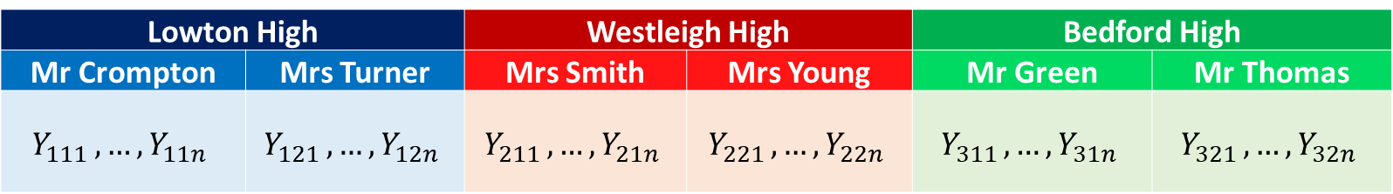
5.1 – Crossed vs Nested Designs
5.1b – Nested Designs:
In a nested design the levels of factor B are not identical across all levels of factor A,
i.e. only some levels of factor B occur within each level of factor A.
We say that the levels of B are ‘nested’ inside levels of factor A.
Typically, we are only interested in whether factor A has any effect on the response variable.
Do the scores that students attain on a maths test differ by school and teacher?
Response Variable Student scores on a math test
Factor A School
Factor A Levels Lowton High, Westleigh High, Bedford High
Factor B Teacher
Factor B Levels Lowton -> (Mr Crompton, Mrs Turner)
Westleigh -> (Mrs Smith, Mrs Young)
Bedford -> (Mr Green, Mr Thomas)
Since the levels of factor B (teachers) are specific to the levels of factor A (school) this is a nested design
Factor A
Lowton High |  | Westleigh High |  | Bedford High
Mr Crompton | Mrs Turner | Mrs Smith | Mrs Young | Mr Green | Mr Thomas
$$Y_{111 },…,Y_{11n}$$ | $$Y_{121 },…,Y_{12n}$$ | $$Y_{211 },…,Y_{21n}$$ | $$Y_{221 },…,Y_{22n}$$ | $$Y_{311 },…,Y_{31n}$$ | $$Y_{321 },…,Y_{32n}$$
Factor B
4

Slide 5
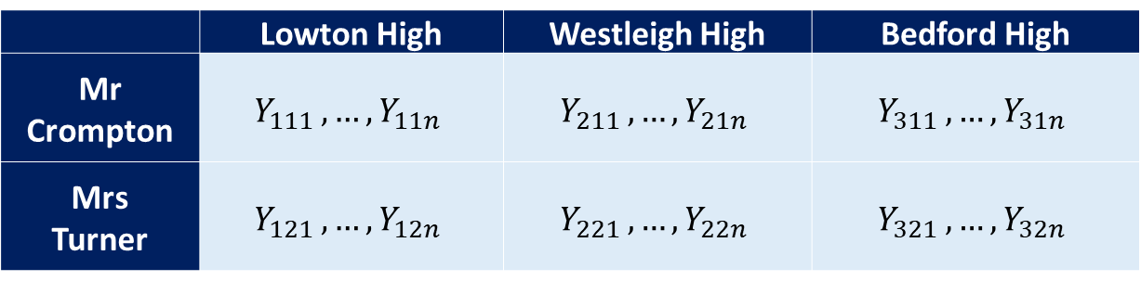
5.1 – Crossed vs Nested Designs
5.1b – Nested Designs:
In a nested design the levels of factor B are not identical across all levels of factor A,
i.e. only some levels of factor B occur within each level of factor A.
We say that the levels of B are ‘nested’ inside levels of factor A.
Typically, we are only interested in whether factor A has any effect on the response variable.
Do the scores that students attain on a maths test differ by school and teacher?
In order for this experiment to be a crossed design, the same two teachers (say Mr Crompton and Mrs Turner)
would have to operate across all three of the schools
Response Variable Student scores on a math test
Factor A School
Factor A Levels Lowton High, Westleigh High, Bedford High
Factor B Teacher
Factor B Levels Mr Crompton, Mrs Turner
This is a crossed design as every level of factor B (teacher) occurs with every level of factor A (school).
Factor A
 | Lowton High | Westleigh High | Bedford High
Mr Crompton | $$Y_{111 },…,Y_{11n}$$ | $$Y_{211 },…,Y_{21n}$$ | $$Y_{311 },…,Y_{31n}$$
Mrs Turner | $$Y_{121 },…,Y_{12n}$$ | $$Y_{221 },…,Y_{22n}$$ | $$Y_{321 },…,Y_{32n}$$
Factor B
5

Slide 6
5.1 – Crossed vs Nested Designs
5.1b – Nested Designs:
Does the purity of prescription drug differ by supplier and batch?
4 batches of the drug are taken from 3 suppliers.
5 purity samples are taken from each batch
Response Variable Drug purity
Factor A Supplier
Factor A Levels Supplier X, Supplier Y, Supplier Z
Factor B Batch
Factor B Levels Supplier X -> {X₁, X₂, X₃, X₄}
Supplier Y -> {Y₁, Y₂, Y₃, Y₄}
Supplier Z -> {Z₁, Z₂, Z₃, Z₄}
Since each batch (Factor B) is specific to each supplier (Factor A) this is an example of a nested design
Factor A
Supplier X |  |  |  | Supplier Y |  |  |  | Supplier Z
X1 | X2 | X3 | X4 | Y1 | Y2 | Y3 | Y4 | Z1 | Z2 | Z3 | Z4
89% | 77% | 93% | 95% | 84% | 97% | 87% | 89% | 78% | 92% | 78% | 92%
81% | 82% | 76% | 80% | 88% | 81% | 81% | 93% | 84% | 97% | 91% | 90%
77% | 98% | 85% | 89% | 96% | 77% | 91% | 75% | 97% | 89% | 99% | 92%
80% | 78% | 91% | 75% | 97% | 75% | 100% | 82% | 75% | 83% | 81% | 92%
94% | 79% | 79% | 99% | 80% | 100% | 95% | 85% | 81% | 97% | 92% | 97%
Factor B
6

Slide 7
5.1 – Crossed vs Nested Designs
5.1b – Nested Designs:
Does the amount of CO2 produced by algae in ponds differ by location and species of algae?
Samples of algae are taken from three different ponds (Pond 1, Pond 2, Pond 3)
Each pond is found to contain two species of algae
Pond 1 contains species X & Y, Pond 2 contains species Y & Z whilst Pond 3 contains species X & Z
5 measurements of the amount of CO2 produced in 30 mins are taken from each pond.
Response Variable CO2 production in 30 min period
Factor A Pond
Factor A Levels Pond1, Pond 2, Pond 3
Factor B Species of Algae
Factor B Levels Pond 1 -> {X,Y} Pond 2 -> {Y,Z} Pond 3 -> {X,Z}
Since only certain species of algae (factor B) are found in each pond (factor A) this is an example of a nested design.
Factor A
Pond 1 |  | Pond 2 |  | Pond 3
X | Y | Y | Z | X | Z
10 | 51 | 18 | 80 | 23 | 12
12 | 55 | 14 | 57 | 22 | 31
19 | 23 | 32 | 65 | 28 | 39
43 | 56 | 22 | 95 | 39 | 38
21 | 58 | 27 | 74 | 40 | 40
Factor B
7

Slide 8
5.2 – Mixed Effects Model for a Two-Stage Nested Design

Slide 9
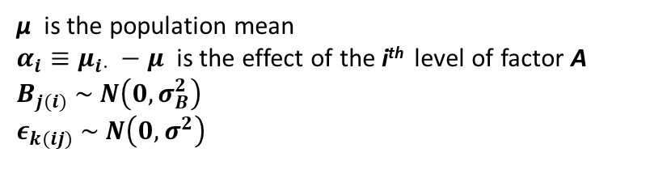

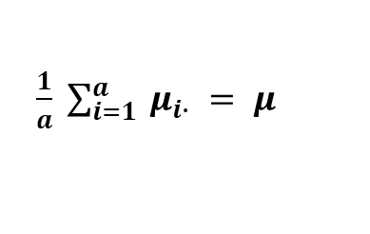
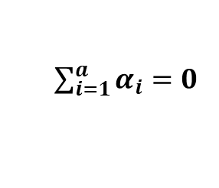
5.2 – Two Stage Nested Design
5.2a – Mixed Effects Model for a 2-Stage Nested Design:
Suppose we have a response variable Y which is modelled as a function of
A factor A with i = 1, … , a levels
A factor B (with b randomly selected levels) nested in factor A
We take a balanced sample of N observations of Y with n observations in each cell. The k^{th} element in cell (i,j) is modelled as
$$Y_{ijk} = μ + α_{i} + B_{j(i)} + ε_{k(ij)}$$
μ is the population mean
$α_{i}≡μ_{i⋅} −μ$ is the effect of the i^{th} level of factor A
$$B_{j(i)} \sim N\left(0, σ_{B}^{2}\right)$$
$$ε_{k(ij)} \sim N\left(0, σ^{2}\right)$$
We also have the usual constraint:
$\sum_{i=1}^{a}{α_{i}=0}$
⬄
$\frac{1}{a} \sum_{i=1}^{a}{ μ_{i∙} = μ }$
$j(i)$ is read as ‘j nested within i’ $k(ij)$ is read as ‘k nested within ij’
9

Slide 10
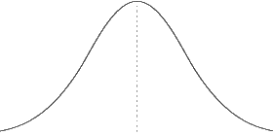






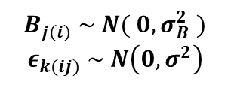
5.2 – Two Stage Nested Design
5.2a – Mixed Effects Model for a 2-Stage Nested Design:
$$Y_{ijk} = μ + α_{i} + B_{j(i)} + ε_{k(ij)}$$
$B_{j(i)} \sim N( 0, σ_{B}^{2} )$
$$ε_{k(ij)} \sim N\left(0, σ^{2}\right)$$
Consider modelling $Y_{ijk}$
$$Y_{ijk}$$
$$α_{i}>0$$
$$μ$$
$$μ+α_{i}$$
$$μ+α_{i}+B_{j(i)}$$
10

Slide 11
5.2 – Two Stage Nested Design
5.2a – Mixed Effects Model for a 2-Stage Nested Design:
Suppose we have a response variable Y which is modelled as a function of
A factor A with i = 1, … , a levels
A factor B (with b randomly selected levels) nested in factor A
We take a balanced sample of N observations of Y with n observations in each cell. The k^{th} element in cell (i,j) is modelled as
$$Y_{ijk} = μ + α_{i} + B_{j(i)} + ε_{k(ij)}$$
μ is the population mean
$α_{i}≡μ_{i⋅} −μ$ is the effect of the i^{th} level of factor A
$$B_{j(i)} \sim N\left(0, σ_{B}^{2}\right)$$
$$ε_{k(ij)} \sim N\left(0, σ^{2}\right)$$
We also have the usual constraint:
$\sum_{i=1}^{a}{α_{i}=0}$
⬄
$\frac{1}{a} \sum_{i=1}^{a}{ μ_{i∙} = μ }$
$j(i)$ is read as ‘j nested within i’ $k(ij)$ is read as ‘k nested within ij’
$$E\left[ Y_{ijk} \right] = E\left[ μ + α_{i} + B_{j\left(i\right)} + ε_{k\left(ij\right)} \right] = E\left[ μ \right] + E\left[ α_{i} \right] + E\left[ B_{j\left(i\right)} \right] + E\left[ ε_{k\left(ij\right)} \right] = μ + α_{i} = μ_{i}.$$
$$Var\left[ Y_{ijk} \right] =Var\left[ μ + α_{i} + B_{j\left(i\right)} + ε_{k\left(ij\right)} \right] =Var\left[ μ \right] +Var\left[ α_{i} \right] +Var\left[ B_{j\left(i\right)} \right] +Var\left[ ε_{k\left(ij\right)} \right]=σ_{B}^{2}\text{ + }σ^{2}$$
11

Slide 12
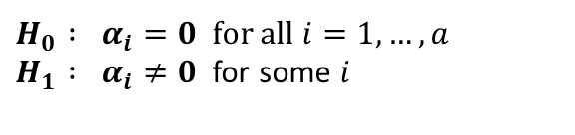
5.2 – Two Stage Nested Design
5.2a – Mixed Effects Model for a 2-Stage Nested Design:
Suppose we have a response variable Y which is modelled as a function of
A factor A with i = 1, … , a levels
A factor B (with b randomly selected levels) nested in factor A
We take a balanced sample of N observations of Y with n observations in each cell. The k^{th} element in cell (i,j) is modelled as
$$Y_{ijk} = μ + α_{i} + B_{j(i)} + ε_{k(ij)}$$
μ is the population mean
$α_{i}≡μ_{i⋅} −μ$ is the effect of the i^{th} level of factor A
$$B_{j(i)} \sim N\left(0, σ_{B}^{2}\right)$$
$$ε_{k(ij)} \sim N\left(0, σ^{2}\right)$$
We also have the usual constraint:
$\sum_{i=1}^{a}{α_{i}=0}$
⬄
$\frac{1}{a} \sum_{i=1}^{a}{ μ_{i∙} = μ }$
$j(i)$ is read as ‘j nested within i’ $k(ij)$ is read as ‘k nested within ij’
We wish to test whether factor A has any effect on the response variable, i.e. we wish to test between the hypotheses:
$H_{0} : α_{i}=0$ for all $i=1, …, a$ $H_{1} : α_{i}≠0$ for some $i$
Note:
Since only some levels of Factor B appear within each level of Factor A there can be no interactions between A and B.
We are not able to test whether Factor B has an effect on the response variable because of the nesting.
12

Slide 13

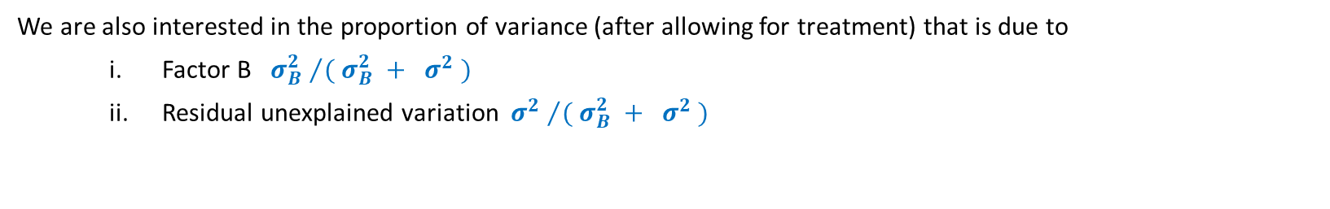
5.2 – Two Stage Nested Design
5.2a – Mixed Effects Model for a 2-Stage Nested Design:
Suppose we have a response variable Y which is modelled as a function of
A factor A with i = 1, … , a levels
A factor B (with b randomly selected levels) nested in factor A
We take a balanced sample of N observations of Y with n observations in each cell. The k^{th} element in cell (i,j) is modelled as
$$Y_{ijk} = μ + α_{i} + B_{j(i)} + ε_{k(ij)}$$
μ is the population mean
$α_{i}≡μ_{i⋅} −μ$ is the effect of the i^{th} level of factor A
$$B_{j(i)} \sim N\left(0, σ_{B}^{2}\right)$$
$$ε_{k(ij)} \sim N\left(0, σ^{2}\right)$$
We also have the usual constraint:
$\sum_{i=1}^{a}{α_{i}=0}$
⬄
$\frac{1}{a} \sum_{i=1}^{a}{ μ_{i∙} = μ }$
$j(i)$ is read as ‘j nested within i’ $k(ij)$ is read as ‘k nested within ij’
$$Var\left[ Y_{ijk} \right] =Var\left[ μ + α_{i} + B_{j\left(i\right)} + ε_{k\left(ij\right)} \right] =Var\left[ μ \right] +Var\left[ α_{i} \right] +Var\left[ B_{j\left(i\right)} \right] +Var\left[ ε_{k\left(ij\right)} \right]=σ_{B}^{2}\text{ + }σ^{2}$$
We are also interested in the proportion of variance (after allowing for treatment) that is due to
Factor B ${σ_{B}^{2} }/{( σ_{B}^{2} + σ^{2} )}$
Residual unexplained variation ${σ^{2} }/{( σ_{B}^{2} + σ^{2} )}$
$σ_{B}^{2}$ and $σ^{2}$ must be estimated from the data.
13

Slide 14
5.2 – Two Stage Nested Design
5.2b – Breakdown of Sums of Squares:
✓
✓
Lemma:
$$Y_{ijk} − {\overline{Y}}_{∙∙∙} = \left({ \overline{Y}}_{i∙∙} − {\overline{Y}}_{∙∙∙} \right) + \left({ \overline{Y}}_{ij∙} − {\overline{Y}}_{i∙∙} \right) + \left(Y_{ijk} −{ \overline{Y}}_{ij∙} \right)$$
Proof: Simply write out the right hand side and collect like terms. □
14

Slide 15
5.2 – Two Stage Nested Design
5.2b – Breakdown of Sums of Squares:
Lemma:
$$Y_{ijk} − {\overline{Y}}_{∙∙∙} = \left({ \overline{Y}}_{i∙∙} − {\overline{Y}}_{∙∙∙} \right) + \left({ \overline{Y}}_{ij∙} − {\overline{Y}}_{i∙∙} \right) + \left(Y_{ijk} −{ \overline{Y}}_{ij∙} \right)$$
Proof: Simply write out the right hand side and collect like terms. □
The model for a mixed effects two stage nested design is given by:
$$Y_{ijk} = μ + α_{i} + B_{j(i)} + ε_{k(ij)}$$
$$Y_{ijk} − μ = α_{i} + B_{j(i)} + ε_{k(ij)}$$
est
est
est
est
$$Y_{ijk} − {\overline{Y}}_{∙∙∙} = \left({ \overline{Y}}_{i∙∙} − {\overline{Y}}_{∙∙∙} \right) + \left({ \overline{Y}}_{ij∙} − {\overline{Y}}_{i∙∙} \right) + \left(Y_{ijk} −{ \overline{Y}}_{ij∙} \right)$$
In particular, $\left(Y_{ijk} −{ \overline{Y}}_{ij∙} \right)$ is an estimate of $ε_{k(ij)}$
15

Slide 16
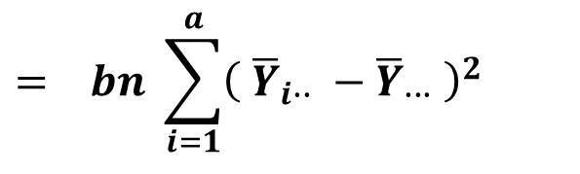
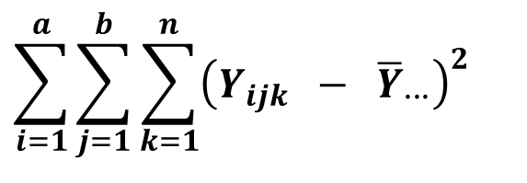
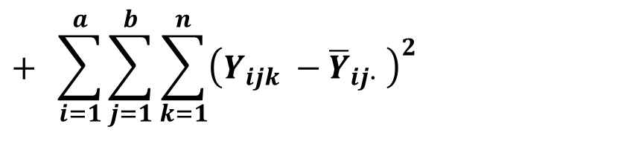
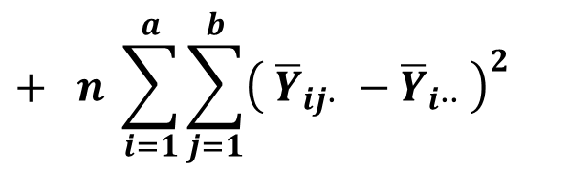
5.2 – Two Stage Nested Design
5.2b – Breakdown of Sums of Squares:
$$Y_{ijk} − {\overline{Y}}_{∙∙∙} = \left({ \overline{Y}}_{i∙∙} − {\overline{Y}}_{∙∙∙} \right) + \left({ \overline{Y}}_{ij∙} − {\overline{Y}}_{i∙∙} \right) + \left(Y_{ijk} −{ \overline{Y}}_{ij∙} \right)$$
If we square both sides of the above equation and sum over all observations we obtain*:
$$\sum_{i=1}^{a}{\sum_{j=1}^{b}{\sum_{k=1}^{n}{{\left(Y_{ijk} − {\overline{Y}}_{∙∙∙}\right)}^{2}}}}$$
Total Sum of Squares (TSS)
$$= bn \sum_{i=1}^{a}{{\left({ \overline{Y}}_{i∙∙} − {\overline{Y}}_{∙∙∙} \right)}^{2}}$$
Sum of Squares for factor A ( SS_{A} )
TSS = SS_{A} + SS_{B(A)} + SSE
$$+ n \sum_{i=1}^{a}{\sum_{j=1}^{b}{{\left({ \overline{Y}}_{ij∙} − {\overline{Y}}_{i∙∙} \right)}^{2}}}$$
Sum of Squares for factor B nested in A ( SS_{B(A)} )
$$+ \sum_{i=1}^{a}{\sum_{j=1}^{b}{\sum_{k=1}^{n}{{\left(Y_{ijk} −{ \overline{Y}}_{ij∙} \right)}^{2}}}}$$
Sum of Squares for Errors (SSE)
16
*The proof of this statement is not required for Stat 293 but is available as supplementary material on the intranet.

Slide 17
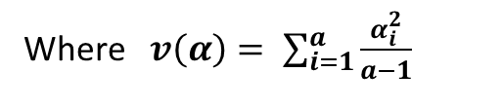
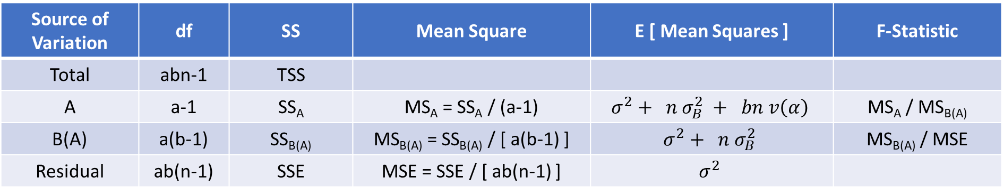
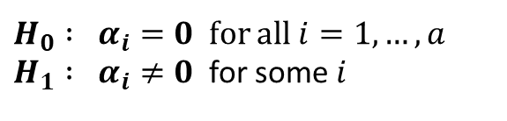
5.2 – Two Stage Nested Design
5.2c – ANOVA Table for a 2-Stage Nested Design:
The ANOVA table below shows all the relevant degrees of freedom, sums of squares, mean squares, expected mean squares and F-Statistics for a mixed effects two stage nested design
Source of Variation | df | SS | Mean Square | E [ Mean Squares ] | F-Statistic
Total | abn-1 | TSS
A | a-1 | SS_{A} | MS_{A} = SS_{A} / (a-1) | $$σ^{2}+ n σ_{B}^{2} + bn v\left(α\right)$$ | MS_{A} / MS_{B(A)}
B(A) | a(b-1) | SS_{B(A)} | MS_{B(A)} = SS_{B(A)} / [ a(b-1) ] | $$σ^{2}+ n σ_{B}^{2}$$ | MS_{B(A)} / MSE
Residual | ab(n-1) | SSE | MSE = SSE / [ ab(n-1) ] | $$σ^{2}$$
Where $v\left(α\right)= \sum_{i=1}^{a}{\frac{α_{i}^{2}}{a−1}}$
We wish to test whether factor A has any effect on the response variable, i.e. we wish to test between the hypotheses:
$H_{0} : α_{i}=0$ for all $i=1, …, a$ $H_{1} : α_{i}≠0$ for some $i$
17

Slide 18
5.2 – Two Stage Nested Design
5.2c – ANOVA Table for a 2-Stage Nested Design:
The ANOVA table below shows all the relevant degrees of freedom, sums of squares, mean squares, expected mean squares and F-Statistics for a mixed effects two stage nested design
Source of Variation | df | SS | Mean Square | E [ Mean Squares ] | F-Statistic
Total | abn-1 | TSS
A | a-1 | SS_{A} | MS_{A} = SS_{A} / (a-1) | $$σ^{2}+ n σ_{B}^{2} + bn v\left(α\right)$$ | MS_{A} / MS_{B(A)}
B(A) | a(b-1) | SS_{B(A)} | MS_{B(A)} = SS_{B(A)} / [ a(b-1) ] | $$σ^{2}+ n σ_{B}^{2}$$ | MS_{B(A)} / MSE
Residual | ab(n-1) | SSE | MSE = SSE / [ ab(n-1) ] | $$σ^{2}$$
Where $v\left(α\right)= \sum_{i=1}^{a}{\frac{α_{i}^{2}}{a−1}}$
Notes:
The error mean square (MSE = s²) is used to estimate $σ^{2}$. This mean square measures the variability from observation to observation.
The Factor B mean square (MS_{B(A)}) reflects variation of two types: differences between observations $σ^{2}$ and differences among Factor B levels ${nσ}_{B}^{2}$. Note the $σ^{2}$ has coefficient 1 (every $Y_{ijk}$ is based one observation) whilst $σ_{B}^{2}$ has coefficient n (every ${\overline{Y}}_{ij.}$ is based on n observations).
The Factor A mean square (MS_{A}) reflects variation of three types: variation among observations $σ^{2}$, variation among Factor B levels ${nσ}_{B}^{2}$and variation among Factor A levels $bn v\left(α\right)$. The coefficient of $v\left(α\right)$is bn since each ${\overline{Y}}_{i..}$ (and hence each $\hat{α_{i}}$) is based on bn observations
18

Slide 19
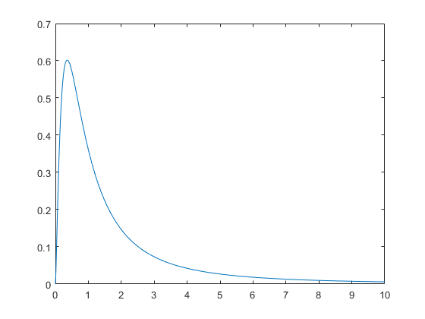

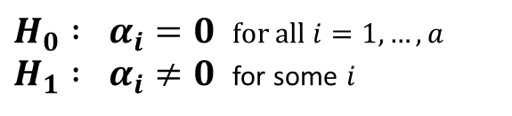

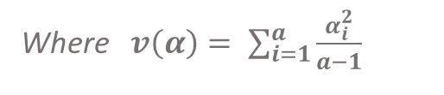

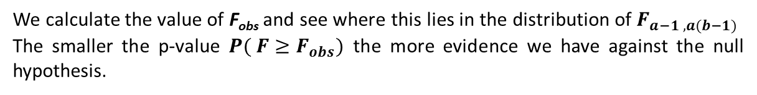
5.2 – Two Stage Nested Design
5.2d – Hypothesis Testing for a 2-Stage Nested Design:
We wish to test whether factor A has any effect on the response variable, i.e. we wish to test between the hypotheses:
$H_{0} : α_{i}=0$ for all $i=1, …, a$ $H_{1} : α_{i}≠0$ for some $i$
The F-statistic for our hypothesis test is:
$$F = \frac{MS_{A}}{MS_{B\left(A\right)}} = \frac{{SS_{A} }/{ (a−1)}}{{SS_{B\left(A\right)} }/{ [ a \left(b−1\right) ]}} = \frac{{bn \sum_{i=1}^{a}{{\left({ \overline{Y}}_{i∙∙} − {\overline{Y}}_{∙∙∙} \right)}^{2}}}/{(a−1)}}{{n \sum_{i=1}^{a}{\sum_{j=1}^{b}{{\left({ \overline{Y}}_{ij∙} − {\overline{Y}}_{i∙∙} \right)}^{2}}}}/{ [ a \left(b−1\right) ]}}$$
We note that:
$$E \left[ F \right]= E\left[\frac{MS_{A}}{ MS_{B\left(A\right) }}\right] ≈ \frac{σ^{2}+ n σ_{B}^{2} + bn v\left(α\right) }{σ^{2}+ n σ_{B}^{2} }$$
Where $v\left(α\right)= \sum_{i=1}^{a}{\frac{α_{i}^{2}}{a−1}}$
On the one hand if H₀ is true => $α_{i} = 0 ∀ i=1, …, a$ => $v\left(α\right)=0$ => $E \left[ F \right]≈ 1$
On the other hand if H₁ is true => $α_{i}≠ 0$for some i => $v\left(α\right)>0$ => $E \left[ F \right]> 1$
The larger the observed test statistic $F_{obs}$ the less likely it is that the null hypothesis is true.
If the usual ANOVA conditions of independence, normality and constant variance hold then $F \sim F_{a−1 , a(b−1)}$
We calculate the value of F_{obs} and see where this lies in the distribution of $F_{a−1 , a(b−1)}$
The smaller the p-value $P( F≥F_{obs})$ the more evidence we have against the null hypothesis.
$$F_{obs}$$
$$P(F≥F_{obs})$$
19

Slide 20
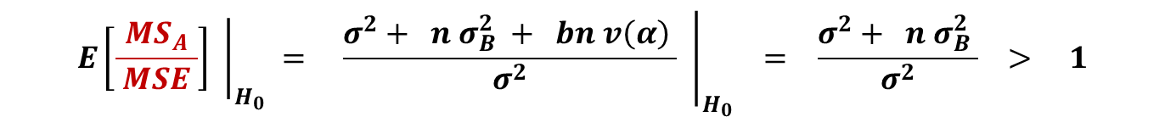

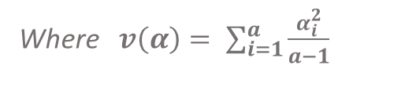
5.2 – Two Stage Nested Design
5.2d – Hypothesis Testing for a 2-Stage Nested Design:
We wish to test whether factor A has any effect on the response variable, i.e. we wish to test between the hypotheses:
$H_{0} : α_{i}=0$ for all $i=1, …, a$ $H_{1} : α_{i}≠0$ for some $i$
Source of Variation | df | SS | Mean Square | E [ Mean Squares ] | F-Statistic
Total | abn-1 | TSS
A | a-1 | SS_{A} | MS_{A} = SS_{A} / (a-1) | $$σ^{2}+ n σ_{B}^{2} + bn v\left(α\right)$$ | MS_{A} / MS_{B(A)}
B(A) | a(b-1) | SS_{B(A)} | MS_{B(A)} = SS_{B(A)} / [ a(b-1) ] | $$σ^{2}+ n σ_{B}^{2}$$ | MS_{B(A)} / MSE
Residual | ab(n-1) | SSE | MSE = SSE / [ ab(n-1) ] | $$σ^{2}$$
Note that:
$${\left.E\left[\frac{MS_{A}}{ MSE }\right] \right|}_{H_{0}} = {\left.\frac{σ^{2}+ n σ_{B}^{2} + bn v\left(α\right) }{σ^{2}} \right|}_{H_{0}} = \frac{σ^{2}+ n σ_{B}^{2} }{σ^{2}} > 1$$
Where $v\left(α\right)= \sum_{i=1}^{a}{\frac{α_{i}^{2}}{a−1}}$
=> $\frac{MS_{A}}{ MSE }$ is not a suitable test statistic for our hypothesis test
20

Slide 21
5.3 – Computational Example of a Mixed Effects Model for a Two-Stage Nested Design

Slide 22
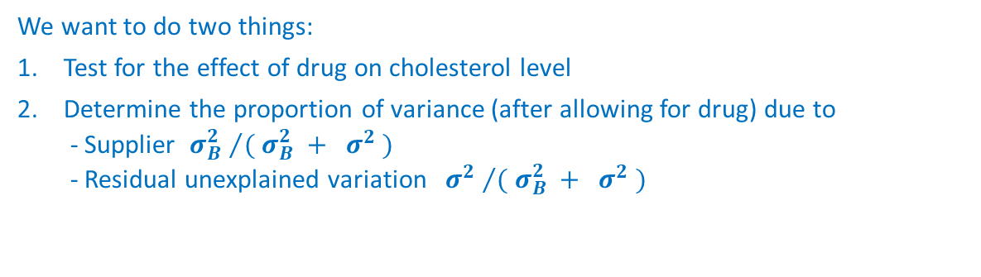
5.3 – Computational Example 2-Stage Nested Design
5.3a – Drug Sourcing Example:
A researcher obtains three different cholesterol lowering drugs. Each drug is sourced from two different suppliers selected at random from all suppliers who make the drug. The researcher wants to know if the drugs differ in their effectiveness. It is possible that different suppliers will be better or worse at making the same drug, so the researcher also uses the factor Supplier to account for this possibility. Each drug from each supplier is given to five people (replicates) randomly selected from volunteers.
The data pertaining to these trials is available in the csv entitled 'drugs’ but is also shown below.
Drug X |  | Drug Y |  | Drug Z
SA | SB | SC | SD | SE | SF
21 | 15 | 14 | 6 | 17 | 7
33 | 18 | 9 | 13 | 25 | 1
18 | 34 | 11 | 13 | 20 | 4
14 | 23 | 22 | 21 | 18 | 16
27 | 26 | 5 | 18 | 31 | 10
Response Variable Cholesterol level
Factor A Drug a = 3
Factor A Levels Drug X, Drug Y, Drug Z
Factor B Supplier b = 2
Factor B Levels X = {SA, SB} Y = {SC, SD} Z = {SE, SF}
Note that since only certain levels of Factor B (Supplier) appear in each level of Factor A (Drug) this is a nested design.
We want to do two things:
Test for the effect of drug on cholesterol level
Determine the proportion of variance (after allowing for drug) due to - Supplier ${σ_{B}^{2} }/{( σ_{B}^{2} + σ^{2} )}$ - Residual unexplained variation ${σ^{2} }/{( σ_{B}^{2} + σ^{2} )}$
There are two ways of doing this
- With the nlme() package ✓
- With the aov() command ✗
22
Associated code = 5.3 - Drug Source (Two Stage Nested Design Example)

Slide 23
5.3 – Computational Example 2-Stage Nested Design
5.3a – Drug Sourcing Example:
Correct ✓
Incorrect ✗
drug | supplier | chol
X | SA | 21
X | SA | 33
X | SA | 18
X | SA | 14
X | SA | 27
X | SB | 15
X | SB | 18
X | SB | 34
X | SB | 23
X | SB | 26
Y | SC | 14
Y | SC | 9
Y | SC | 11
Y | SC | 22
Y | SC | 5
Y | SD | 6
Y | SD | 13
Y | SD | 13
Y | SD | 21
Y | SD | 18
drug | supplier | chol
X | S1 | 21
X | S1 | 33
X | S1 | 18
X | S1 | 14
X | S1 | 27
X | S2 | 15
X | S2 | 18
X | S2 | 34
X | S2 | 23
X | S2 | 26
Y | S1 | 14
Y | S1 | 9
Y | S1 | 11
Y | S1 | 22
Y | S1 | 5
Y | S2 | 6
Y | S2 | 13
Y | S2 | 13
Y | S2 | 21
Y | S2 | 18
Note that when using a nested design it is important how the data are labelled when entering them into R.
It is essential that each nested level of factor B is given its own unique label, i.e. labels are not repeated. In this case each supplier should be given its own unique label.
If we had re-used the labels S1 and S2 for factor B levels within each level of factor A, R would have interpreted this as a crossed rather than nested design.
It is essential that you use unique labels for each level of Factor B so that R interprets the design as nested rather than crossed!
23
Associated code = 5.3 - Drug Source (Two Stage Nested Design Example)

Slide 24
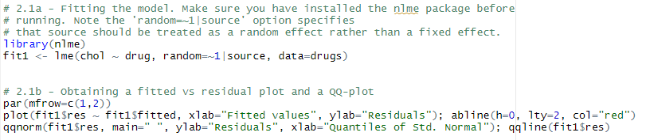

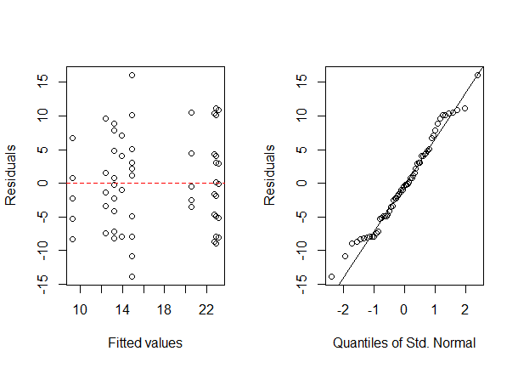

5.3 – Computational Example 2-Stage Nested Design
5.3a – Drug Sourcing Example:
Checking ANOVA Assumptions
Fitted vs Residual plot suggests constant variance
QQ-plot suggests that their may be a departure from normality in the tails of the distribution
Shapiro-Wilks test shows no evidence that the data is not normally distributed
24
Associated code = 5.3 - Drug Source (Two Stage Nested Design Example)

Slide 25

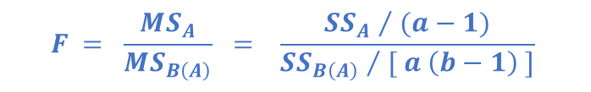
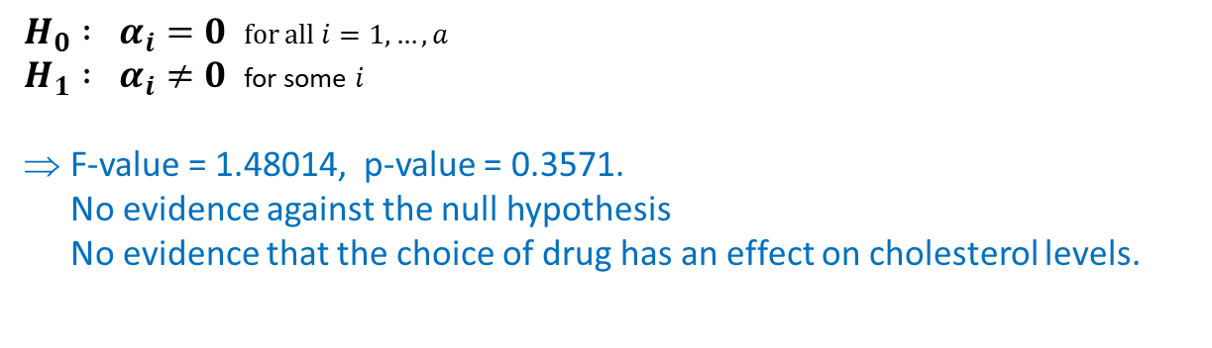
5.3 – Computational Example 2-Stage Nested Design
5.3a – Drug Sourcing Example:
$$F = \frac{MS_{A}}{MS_{B\left(A\right)}} = \frac{{SS_{A} }/{ (a−1)}}{{SS_{B\left(A\right)} }/{ [ a \left(b−1\right) ]}}$$
Test of Factor A effects using the nlme package ✓
Source of Variation | df | SS | Mean Square | F-Statistic
Total | abn-1 | TSS
A | a-1 | SS_{A} | MS_{A} = SS_{A} / (a-1) | MS_{A} / MS_{B(A)}
B(A) | a(b-1) | SS_{B(A)} | MS_{B(A)} = SS_{B(A)} / [ a(b-1) ] | MS_{B(A)} / MSE
Residual | ab(n-1) | SSE | MSE = SSE / [ ab(n-1) ]
$H_{0} : α_{i}=0$ for all $i=1, …, a$ $H_{1} : α_{i}≠0$ for some $i$
F-value = 1.48014, p-value = 0.3571. No evidence against the null hypothesis No evidence that the choice of drug has an effect on cholesterol levels.
25
Associated code = 5.3 - Drug Source (Two Stage Nested Design Example)

Slide 26
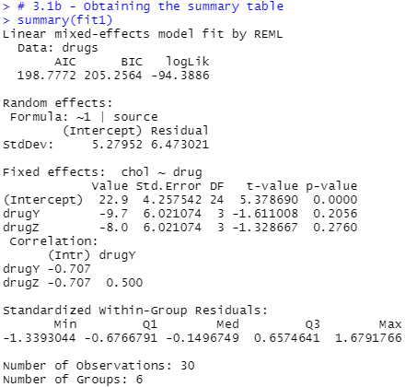
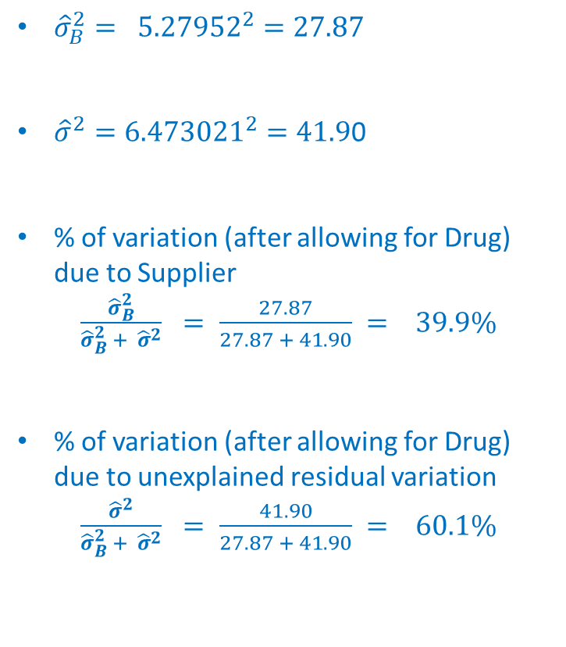
5.3 – Computational Example 2-Stage Nested Design
5.3a – Drug Sourcing Example:
Calculating proportion of variance using the nlme package ✓
${\hat{σ}}_{B}^{2}= {5.27952}^{2}=27.87$
${\hat{σ}}^{2}={6.473021}^{2}=41.9$0
% of variation (after allowing for Drug) due to Supplier
$\frac{{\hat{σ}}_{B}^{2}}{{\hat{σ}}_{B}^{2} + {\hat{σ}}^{2}} = \frac{27.87}{27.87 + 41.90} = 39.9\%$
% of variation (after allowing for Drug) due to unexplained residual variation
$\frac{{\hat{σ}}^{2}}{{\hat{σ}}_{B}^{2} + {\hat{σ}}^{2}} = \frac{41.90}{27.87 + 41.90} = 60.1\%$
supplier
26
Associated code = 5.3 - Drug Source (Two Stage Nested Design Example)

Slide 27

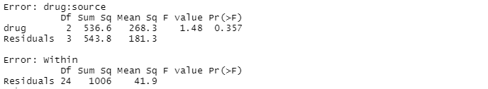
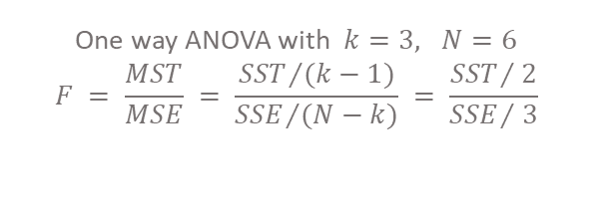
5.3 – Computational Example 2-Stage Nested Design
5.3a – Drug Sourcing Example:
Test of Factor A effects using the aov() command ✗
The first table is an ANOVA table for the fixed effect of Drug.
This is essentially a one-way ANOVA of Drug using just six observations, which are the means for each of the six suppliers. This explains the (2,3) df.
It is done this way because we want to know how much variability there is among drugs after the supplier effect has been allowed for.
F-value = 1.48, p-value = 0.357 Same as before No evidence against the null hypothesis
Drug X |  | Drug Y |  | Drug Z
SA | SB | SC | SD | SE | SF
21 | 15 | 14 | 6 | 17 | 7
33 | 18 | 9 | 13 | 25 | 1
18 | 34 | 11 | 13 | 20 | 4
14 | 23 | 22 | 21 | 18 | 16
27 | 26 | 5 | 18 | 31 | 10
One way ANOVA with $k=3, N=6$
$$F = \frac{MST}{MSE} = \frac{{SST}/{(k−1)}}{{SSE}/{(N−k)}} = \frac{{SST}/{ 2}}{{SSE}/{ 3}}$$
Drug X | Drug Y | Drug Z
22.6 | 12.2 | 22.2
23.2 | 14.2 | 7.6
27
Associated code = 5.3 - Drug Source (Two Stage Nested Design Example)

Slide 28
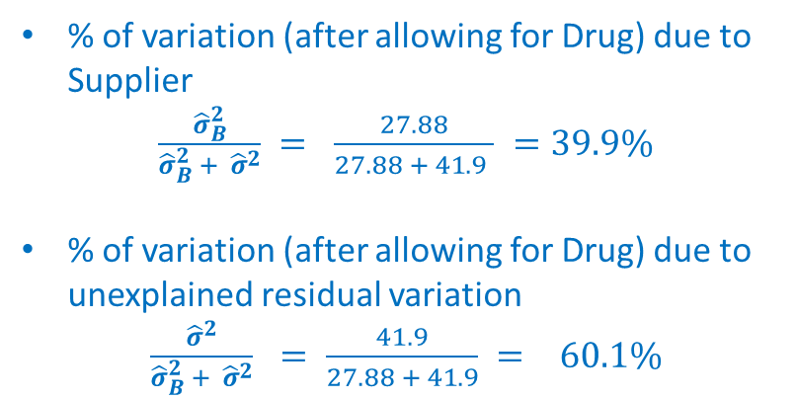
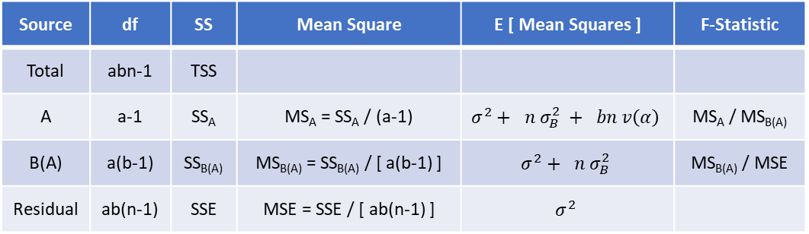
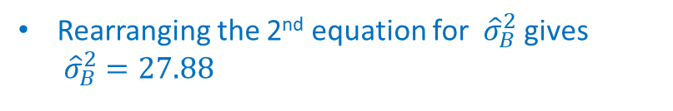
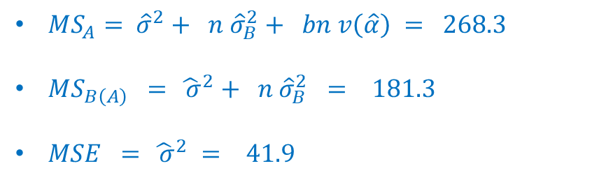
5.3 – Computational Example 2-Stage Nested Design
5.3a – Drug Sourcing Example:
Calculating proportion of variance using the aov() command ✗
b = 2
$MS_{A}= {\hat{σ}}^{2}+ n{ \hat{σ}}_{B}^{2}+ bn v\left(\hat{α}\right) = 268.3$
$MS_{B\left(A\right)} = {\hat{ σ}}^{2}+ n{ \hat{σ}}_{B}^{2} = 181.3$
$MSE = {\hat{ σ}}^{2} = 41.9$
n = 5
Rearranging the 2nd equation for ${ \hat{σ}}_{B}^{2}$gives ${ \hat{σ}}_{B}^{2} =27.88$
% of variation (after allowing for Drug) due to Supplier
$\frac{{\hat{σ}}_{B}^{2}}{{\hat{σ}}_{B}^{2} + {\hat{σ}}^{2}} = \frac{27.88}{27.88 + 41.9 } =39.9\%$
% of variation (after allowing for Drug) due to unexplained residual variation
$\frac{{\hat{σ}}^{2}}{{\hat{σ}}_{B}^{2} + {\hat{σ}}^{2}} = \frac{41.9}{27.88 + 41.9} = 60.1\%$
Source | df | SS | Mean Square | E [ Mean Squares ] | F-Statistic
Total | abn-1 | TSS
A | a-1 | SS_{A} | MS_{A} = SS_{A} / (a-1) | $$σ^{2}+ n σ_{B}^{2} + bn v\left(α\right)$$ | MS_{A} / MS_{B(A)}
B(A) | a(b-1) | SS_{B(A)} | MS_{B(A)} = SS_{B(A)} / [ a(b-1) ] | $$σ^{2}+ n σ_{B}^{2}$$ | MS_{B(A)} / MSE
Residual | ab(n-1) | SSE | MSE = SSE / [ ab(n-1) ] | $$σ^{2}$$
28
Associated code = 5.3 - Drug Source (Two Stage Nested Design Example)

Slide 29
5.4 – Mixed Effects Model for a Three-Stage Nested Design

Slide 30
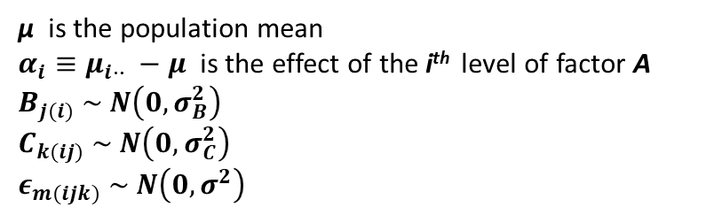
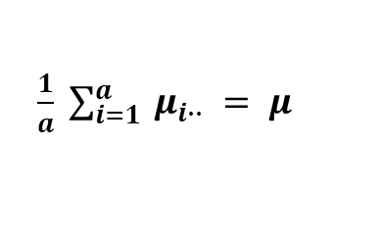
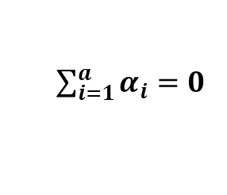
5.4 – 3-Stage Nested Design
5.4a – Mixed Effects Model for a 3-Stage Nested Design:
Suppose we have a response variable Y which is modelled as a function of
a factor A with i = 1, … , a levels
a factor B with b randomly selected levels nested in factor A
a factor C with c randomly selected levels nested in factor B
We take a balanced sample of N observations with n observations in each cell. The m^{th} element in cell (i,j,k) is modelled as:
$$Y_{ijkm} = μ + α_{i} + B_{j(i)} + C_{k(ij)} + ε_{m(ijk)}$$
μ is the population mean
$α_{i}≡μ_{i⋅∙} −μ$ is the effect of the i^{th} level of factor A
$$B_{j(i)} \sim N\left(0, σ_{B}^{2}\right)$$
$$C_{k(ij)} \sim N\left(0, σ_{C}^{2}\right)$$
$$ε_{m(ijk)} \sim N\left(0, σ^{2}\right)$$
We also have the usual constraints:
$\sum_{i=1}^{a}{α_{i}=0}$
⬄
$\frac{1}{a} \sum_{i=1}^{a}{ μ_{i∙∙} = μ }$
30

Slide 31




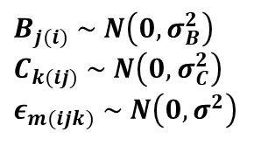
5.2 – Two Stage Nested Design
5.4 – 3-Stage Nested Design
5.4a – Mixed Effects Model for a 3-Stage Nested Design:
$$Y_{ijkm} = μ + α_{i} + B_{j(i)} + C_{k(ij)} + ε_{m(ijk)}$$
$$B_{j(i)} \sim N\left(0, σ_{B}^{2}\right)$$
$$C_{k(ij)} \sim N\left(0, σ_{C}^{2}\right)$$
$$ε_{m(ijk)} \sim N\left(0, σ^{2}\right)$$
Consider modelling $Y_{ijkm}$
$$Y_{ijkm}$$
$$α_{i}>0$$
$$μ$$
$$μ+α_{i}+B_{j(i)}$$
$$μ+α_{i}+B_{j(i)}+C_{k\left(ij\right)}$$
$$μ+α_{i}$$
31

Slide 32
5.4 – 3-Stage Nested Design
5.4a – Mixed Effects Model for a 3-Stage Nested Design:
Suppose we have a response variable Y which is modelled as a function of
a factor A with i = 1, … , a levels
a factor B with b randomly selected levels nested in factor A
a factor C with c randomly selected levels nested in factor B
We take a balanced sample of N observations with n observations in each cell. The m^{th} element in cell (i,j,k) is modelled as:
$$Y_{ijkm} = μ + α_{i} + B_{j(i)} + C_{k(ij)} + ε_{m(ijk)}$$
μ is the population mean
$α_{i}≡μ_{i⋅∙} −μ$ is the effect of the i^{th} level of factor A
$$B_{j(i)} \sim N\left(0, σ_{B}^{2}\right)$$
$$C_{k(ij)} \sim N\left(0, σ_{C}^{2}\right)$$
$$ε_{m(ijk)} \sim N\left(0, σ^{2}\right)$$
We also have the usual constraints:
$\sum_{i=1}^{a}{α_{i}=0}$
⬄
$\frac{1}{a} \sum_{i=1}^{a}{ μ_{i∙∙} = μ }$
$$E\left[ Y_{ijkm} \right] = E\left[ μ + α_{i} + B_{j\left(i\right)} + { C}_{k(ij)} +{ ε}_{m(ijk)}\right] = E\left[ μ \right] + E\left[ α_{i} \right] + E\left[ B_{j\left(i\right)} \right] +E\left[{ C}_{k(ij)}\right] + E\left[ε_{m(ijk)}\right]$$
$= μ + α_{i} = μ_{i}..$
$$Var\left[ Y_{ijkm} \right] =Var\left[ μ + α_{i} + B_{j\left(i\right)} + { C}_{k(ij)} +{ ε}_{m(ijk)}\right] =Var\left[ μ \right] +Var\left[ α_{i} \right] +Var\left[ B_{j\left(i\right)} \right] +Var\left[{ C}_{k(ij)}\right] + Var\left[ε_{m(ijk)}\right]$$
$=σ_{B}^{2} + σ_{C}^{2} +{ σ}^{2}$
32

Slide 33
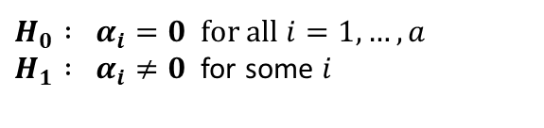
5.4 – 3-Stage Nested Design
5.4a – Mixed Effects Model for a 3-Stage Nested Design:
Suppose we have a response variable Y which is modelled as a function of
a factor A with i = 1, … , a levels
a factor B with b randomly selected levels nested in factor A
a factor C with c randomly selected levels nested in factor B
We take a balanced sample of N observations with n observations in each cell. The m^{th} element in cell (i,j,k) is modelled as:
$$Y_{ijkm} = μ + α_{i} + B_{j(i)} + C_{k(ij)} + ε_{m(ijk)}$$
μ is the population mean
$α_{i}≡μ_{i⋅∙} −μ$ is the effect of the i^{th} level of factor A
$$B_{j(i)} \sim N\left(0, σ_{B}^{2}\right)$$
$$C_{k(ij)} \sim N\left(0, σ_{C}^{2}\right)$$
$$ε_{m(ijk)} \sim N\left(0, σ^{2}\right)$$
We also have the usual constraints:
$\sum_{i=1}^{a}{α_{i}=0}$
⬄
$\frac{1}{a} \sum_{i=1}^{a}{ μ_{i∙∙} = μ }$
We wish to test whether factor A has any effect on the response variable, i.e. we wish to test between the hypotheses:
$H_{0} : α_{i}=0$ for all $i=1, …, a$ $H_{1} : α_{i}≠0$ for some $i$
Note:
33
Since only some levels of Factor B (C) appear within each level of Factor A (B) there can be no interactions between A, B & C.
We are not able to test whether Factor B or Factor C has an effect on the response variable because of the nesting.

Slide 34
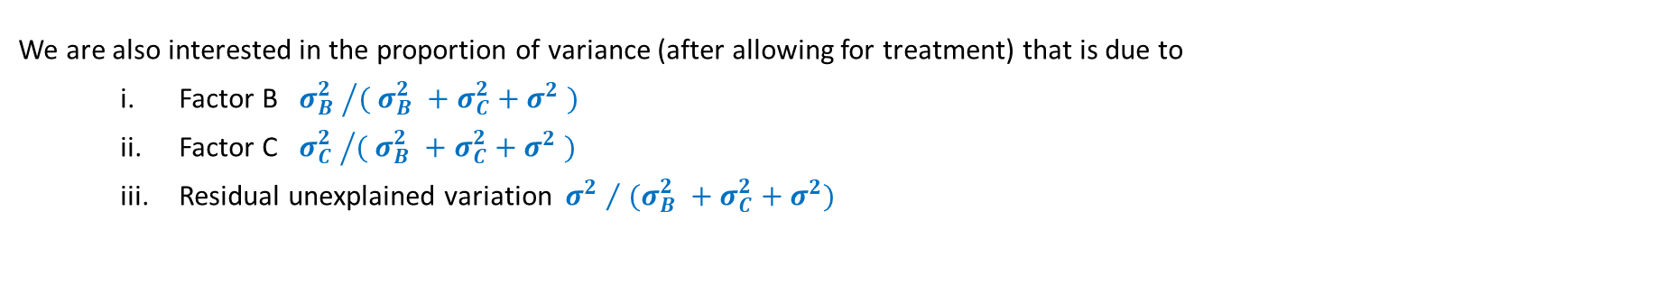
5.4 – 3-Stage Nested Design
5.4a – Mixed Effects Model for a 3-Stage Nested Design:
Suppose we have a response variable Y which is modelled as a function of
a factor A with i = 1, … , a levels
a factor B with b randomly selected levels nested in factor A
a factor C with c randomly selected levels nested in factor B
We take a balanced sample of N observations with n observations in each cell. The m^{th} element in cell (i,j,k) is modelled as:
$$Y_{ijkm} = μ + α_{i} + B_{j(i)} + C_{k(ij)} + ε_{m(ijk)}$$
μ is the population mean
$α_{i}≡μ_{i⋅∙} −μ$ is the effect of the i^{th} level of factor A
$$B_{j(i)} \sim N\left(0, σ_{B}^{2}\right)$$
$$C_{k(ij)} \sim N\left(0, σ_{C}^{2}\right)$$
$$ε_{m(ijk)} \sim N\left(0, σ^{2}\right)$$
We also have the usual constraints:
$\sum_{i=1}^{a}{α_{i}=0}$
⬄
$\frac{1}{a} \sum_{i=1}^{a}{ μ_{i∙∙} = μ }$
$$Var\left[ Y_{ijkm} \right] =σ_{B}^{2} + σ_{C}^{2} +{ σ}^{2}$$
We are also interested in the proportion of variance (after allowing for treatment) that is due to
Factor B ${σ_{B}^{2} }/{( σ_{B}^{2} +σ_{C}^{2}+σ^{2} )}$
Factor C ${σ_{C}^{2} }/{( σ_{B}^{2} +σ_{C}^{2}+σ^{2} )}$
Residual unexplained variation ${σ^{2} }/{ (σ_{B}^{2} +σ_{C}^{2}+σ^{2})}$
34

Slide 35
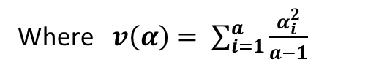
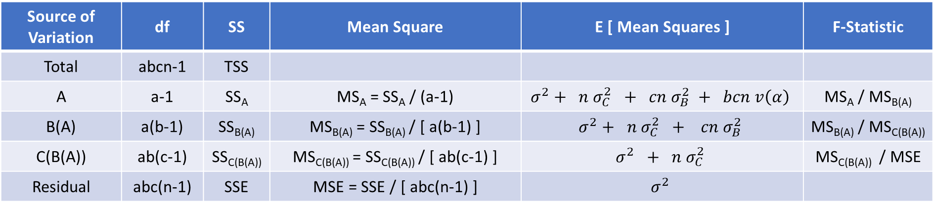
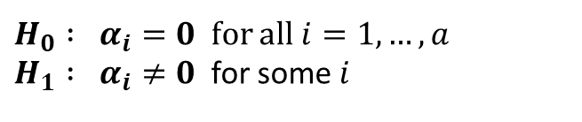
5.4 – 3-Stage Nested Design
5.4b – ANOVA Table for a 3-Stage Nested Design:
The ANOVA table below shows all the relevant degrees of freedom, sums of squares, mean squares, expected mean squares and F-Statistics for a mixed effects three stage nested design
Source of Variation | df | SS | Mean Square | E [ Mean Squares ] | F-Statistic
Total | abcn-1 | TSS
A | a-1 | SS_{A} | MS_{A} = SS_{A} / (a-1) | $$σ^{2}+ n σ_{C}^{2} + cn σ_{B}^{2} + bcn v\left(α\right)$$ | MS_{A} / MS_{B(A)}
B(A) | a(b-1) | SS_{B(A)} | MS_{B(A)} = SS_{B(A)} / [ a(b-1) ] | $$σ^{2}+ n σ_{C}^{2} + cn σ_{B}^{2}$$ | MS_{B(A)} / MS_{C(B(A))}
C(B(A)) | ab(c-1) | SS_{C(B(A))} | MS_{C(B(A))} = SS_{C(B(A))} / [ ab(c-1) ] | $$σ^{2} + n σ_{C}^{2}$$ | MS_{C(B(A))} / MSE
Residual | abc(n-1) | SSE | MSE = SSE / [ abc(n-1) ] | $$σ^{2}$$
We wish to test whether factor A has any effect on the response variable, i.e. we wish to test between the hypotheses:
Where $v\left(α\right)= \sum_{i=1}^{a}{\frac{α_{i}^{2}}{a−1}}$
$H_{0} : α_{i}=0$ for all $i=1, …, a$ $H_{1} : α_{i}≠0$ for some $i$
35

Slide 36
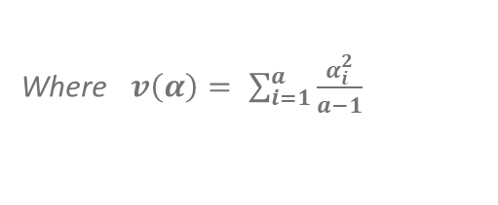
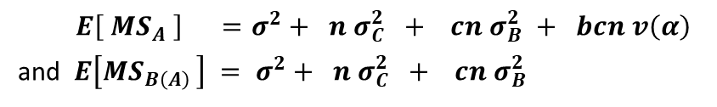
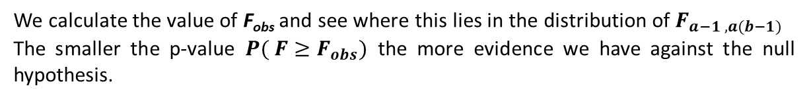
5.4 – 3-Stage Nested Design
5.4c – Hypothesis Testing for a 3-Stage Nested Design:
We wish to test whether factor A has any effect on the response variable, i.e. we wish to test between the hypotheses:
$H_{0} : α_{i}=0$ for all $i=1, …, a$ $H_{1} : α_{i}≠0$ for some $i$
The F-statistic for our hypothesis test is:
$$F = \frac{MS_{A}}{MS_{B\left(A\right)}} = \frac{{SS_{A} }/{ (a−1)}}{{SS_{B\left(A\right)} }/{ [ a \left(b−1\right) ]}}$$
We note that:
$E\left[ MS_{A} \right] =σ^{2}+ n σ_{C}^{2} + cn σ_{B}^{2} + bcn v\left(α\right)$
and $E\left[MS_{B\left(A\right) }\right] = σ^{2}+ n σ_{C}^{2} + cn σ_{B}^{2}$
Where $v\left(α\right)= \sum_{i=1}^{a}{\frac{α_{i}^{2}}{a−1}}$
On the one hand if H₀ is true => $α_{i} = 0 ∀ i=1, …, a$ => $v\left(α\right)=0$ => $E \left[ F \right]= 1$
On the other hand if H₁ is true => $α_{i}≠ 0$for some i => $v\left(α\right)>0$ => $E \left[ F \right]> 1$
The larger the observed test statistic $F_{obs}$ the less likely it is that the null hypothesis is true.
If the usual ANOVA conditions hold in each cell then $F \sim F_{a−1 , a(b−1)}$
We calculate the value of F_{obs} and see where this lies in the distribution of $F_{a−1 , a(b−1)}$
The smaller the p-value $P( F≥F_{obs})$ the more evidence we have against the null hypothesis.
$$F_{obs}$$
$$P(F≥F_{obs})$$
36

Slide 37
5.5 – Computational Example of a Mixed Effects Model for a Three-Stage Nested Design

Slide 38
5.5 – Computational Example 3-Stage Nested Design
5.5a – Burger Fat Example:
An experiment is conducted to study the fat content of popular burgers from a large fast food restaurant chain. Particular interest centres on whether fat content varies significantly with geographic region, town or restaurant. Three towns are randomly selected in the North and three more are selected in the South. In each town, three restaurants are randomly chosen and at each restaurant, five burgers are randomly chosen and prepared in a typical fashion. Each burger is then ground up, and the total amount of fat is determined. The response is expressed in a coded scale for computational convenience.
The data pertaining to these trials is available in the csv data set entitled 'burger’ but is also shown below.
North |  |  |  |  |  |  |  |  | South
Town1 |  |  | Town2 |  |  | Town3 |  |  | Town4 |  |  | Town5 |  |  | Town6
Rest1 | Rest2 | Rest3 | Rest4 | Rest5 | Rest6 | Rest7 | Rest8 | Rest9 | Rest10 | Rest11 | Rest12 | Rest13 | Rest14 | Rest15 | Rest16 | Rest17 | Rest18
4 | 3 | 4 | 7 | 8 | 7 | 4 | 5 | 9 | 7 | 8 | 4 | 3 | 6 | 3 | 11 | 9 | 4
6 | 4 | 5 | 9 | 7 | 6 | 6 | 7 | 4 | 10 | 6 | 7 | 5 | 7 | 2 | 12 | 8 | 5
5 | 4 | 7 | 11 | 9 | 10 | 7 | 3 | 8 | 10 | 9 | 8 | 4 | 4 | 5 | 9 | 10 | 5
4 | 5 | 4 | 10 | 6 | 8 | 7 | 6 | 6 | 9 | 10 | 8 | 5 | 5 | 6 | 9 | 10 | 8
3 | 3 | 6 | 12 | 10 | 9 | 6 | 4 | 7 | 11 | 9 | 9 | 4 | 6 | 4 | 10 | 8 | 4
Response Variable Fat content (grams)
Factor A Region
Factor A Levels North, South a = 2
Factor B Town
Factor B Levels Town 1 – Town 6 (nested in Region) b = 3
Factor C Restaurant
Factor C Levels Restaurant 1 – Town 18 (nested in Town) c = 3
Note that since:
each Town (Factor B) is nested in each Region (Factor A)
each Restaurant (Factor C) is nested in each Town (Factor B)
This is a 3-stage nested design.
38
Associated code = 5.5 - Burger Fat (Three Stage Nested Design Example)

Slide 39
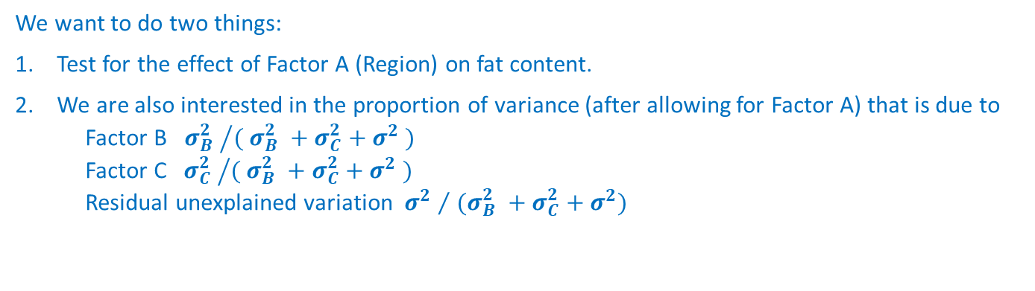
5.5 – Computational Example 3-Stage Nested Design
5.5a – Burger Fat Example:
An experiment is conducted to study the fat content of popular burgers from a large fast food restaurant chain. Particular interest centres on whether fat content varies significantly with geographic region, town or restaurant. Three towns are randomly selected in the North and three more are selected in the South. In each town, three restaurants are randomly chosen and at each restaurant, five burgers are randomly chosen and prepared in a typical fashion. Each burger is then ground up, and the total amount of fat is determined. The response is expressed in a coded scale for computational convenience.
The data pertaining to these trials is available in the csv data set entitled 'burger’ but is also shown below.
North |  |  |  |  |  |  |  |  | South
Town1 |  |  | Town2 |  |  | Town3 |  |  | Town4 |  |  | Town5 |  |  | Town6
Rest1 | Rest2 | Rest3 | Rest4 | Rest5 | Rest6 | Rest7 | Rest8 | Rest9 | Rest10 | Rest11 | Rest12 | Rest13 | Rest14 | Rest15 | Rest16 | Rest17 | Rest18
4 | 3 | 4 | 7 | 8 | 7 | 4 | 5 | 9 | 7 | 8 | 4 | 3 | 6 | 3 | 11 | 9 | 4
6 | 4 | 5 | 9 | 7 | 6 | 6 | 7 | 4 | 10 | 6 | 7 | 5 | 7 | 2 | 12 | 8 | 5
5 | 4 | 7 | 11 | 9 | 10 | 7 | 3 | 8 | 10 | 9 | 8 | 4 | 4 | 5 | 9 | 10 | 5
4 | 5 | 4 | 10 | 6 | 8 | 7 | 6 | 6 | 9 | 10 | 8 | 5 | 5 | 6 | 9 | 10 | 8
3 | 3 | 6 | 12 | 10 | 9 | 6 | 4 | 7 | 11 | 9 | 9 | 4 | 6 | 4 | 10 | 8 | 4
We want to do two things:
Test for the effect of Factor A (Region) on fat content.
We are also interested in the proportion of variance (after allowing for Factor A) that is due to Factor B ${σ_{B}^{2} }/{( σ_{B}^{2} +σ_{C}^{2}+σ^{2} )}$ Factor C ${σ_{C}^{2} }/{( σ_{B}^{2} +σ_{C}^{2}+σ^{2} )}$ Residual unexplained variation ${σ^{2} }/{ (σ_{B}^{2} +σ_{C}^{2}+σ^{2})}$
There are two ways of doing this
- With the nlme() package ✓
- With the aov() command ✗
39
Associated code = 5.5 - Burger Fat (Three Stage Nested Design Example)

Slide 40
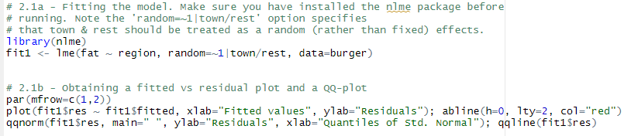
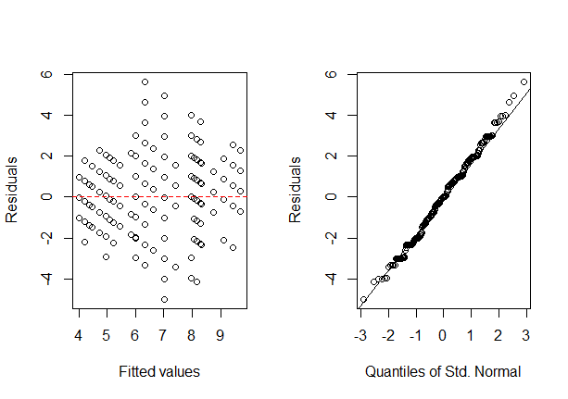

5.5 – Computational Example 3-Stage Nested Design
5.5a – Burger Fat Example:
Checking ANOVA Assumptions
Fitted vs Residual plot suggests constant(ish) variance
QQ-plot suggests that their may be a departure from normality in the tails of the distribution
Shapiro-Wilks test shows no evidence that the data is not normally distributed
40
Associated code = 5.5 - Burger Fat (Three Stage Nested Design Example)

Slide 41

5.5 – Computational Example 3-Stage Nested Design
5.5a – Burger Fat Example:
Test of Factor A effects using the nlme package ✓
F-value = 0.16176, p-value = 0.7081. No evidence against the null hypothesis No evidence that fat content differs between region
lme() creates an ANOVA table for the fixed effect factor only. Variation due to random effects can be calculated using variance components (see next slide).
41
Associated code = 5.5 - Burger Fat (Three Stage Nested Design Example)

Slide 42


5.5 – Computational Example 3-Stage Nested Design
5.5a – Burger Fat Example:
${\hat{σ}}_{B}^{2}= {1.944218}^{2}=3.7800$
${\hat{σ}}_{C}^{2}= {1.198628}^{2}=1.4367$
${\hat{σ}}^{2}= {1.458688}^{2} =2.1278$
% of variance (after adjusting for Region) due to town-to-town differences
$\frac{{\hat{σ}}_{B}^{2}}{{\hat{σ}}_{B}^{2}+{ \hat{σ}}_{C}^{2} + {\hat{σ}}^{2}} = 51.5\%$
% of variance (after adjusting for Region) due to Restaurant-to-Restaurant differences
$\frac{{\hat{σ}}_{C}^{2}}{{\hat{σ}}_{B}^{2}+{ \hat{σ}}_{C}^{2} + {\hat{σ}}^{2}} = 19.6\%$
% of variance (after adjusting for Region) due to unexplained residual variation
$\frac{{\hat{σ}}^{2}}{{\hat{σ}}_{B}^{2}+{ \hat{σ}}_{C}^{2} + {\hat{σ}}^{2}} = 28.9\%$
Calculating proportion of variance using the nlme package ✓
42
Associated code = 5.5 - Burger Fat (Three Stage Nested Design Example)

Slide 43


5.5 – Computational Example 3-Stage Nested Design
5.5a – Burger Fat Example:
Test of Factor A effects using the aov() command ✗
F-value = 0.16176, p-value = 0.7081. No evidence against the null hypothesis No evidence that fat content differs between region
Same as before!
43
Associated code = 5.5 - Burger Fat (Three Stage Nested Design Example)

Slide 44


5.5 – Computational Example 3-Stage Nested Design
5.5a – Burger Fat Example:
$MS_{A}= {\hat{σ}}^{2}+ n{ \hat{σ}}_{C}^{2} + cn{ \hat{σ}}_{B}^{2}+ bcn v\left(\hat{α}\right) = 10.68$
$MS_{B\left(A\right)} ={\hat{σ}}^{2}+ n{ \hat{σ}}_{C}^{2} + cn{ \hat{σ}}_{B}^{2}= 66.01$
$MS_{C(B\left(A\right))} ={\hat{σ}}^{2}+ n{ \hat{σ}}_{C}^{2} = 9.311$
$MSE = {\hat{ σ}}^{2} = 2.128$
Rearranging the 3rd equation for ${ \hat{σ}}_{C}^{2}$gives ${ \hat{σ}}_{C}^{2} =1.4366$
Then rearranging the 2nd equation for ${ \hat{σ}}_{B}^{2}$gives ${ \hat{σ}}_{B}^{2} =3.7800$
% of variance (after adjusting for Region) due to town-to-town differences
$\frac{{\hat{σ}}_{B}^{2}}{{\hat{σ}}_{B}^{2}+{ \hat{σ}}_{C}^{2} + {\hat{σ}}^{2}} = 51.5\%$
% of variance (after adjusting for Region) due to Restaurant-to-Restaurant
$\frac{{\hat{σ}}_{C}^{2}}{{\hat{σ}}_{B}^{2}+{ \hat{σ}}_{C}^{2} + {\hat{σ}}^{2}} = 19.6\%$
% of variance (after adjusting for Region) due to unexplained residual variation
$\frac{{\hat{σ}}^{2}}{{\hat{σ}}_{B}^{2}+{ \hat{σ}}_{C}^{2} + {\hat{σ}}^{2}} = 28.9\%$
Calculating proportion of variance using the aov() command ✗
Source | Mean Square | E [ Mean Squares ]
Total
A | MS_{A} = SS_{A} / (a-1) | $$σ^{2}+ n σ_{C}^{2} + cn σ_{B}^{2} + bcn v\left(α\right)$$
B(A) | MS_{B(A)} = SS_{B(A)} / [ a(b-1) ] | $$σ^{2}+ n σ_{C}^{2} + cn σ_{B}^{2}$$
C(B(A)) | MS_{C(B(A))} = SS_{C(B(A))} / [ ab(c-1) ] | $$σ^{2} + n σ_{C}^{2}$$
Residual | MSE = SSE / [ ab(n-1) ] | $$σ^{2}$$
44
Associated code = 5.5 - Burger Fat (Three Stage Nested Design Example)

